Slide 1
Cloudamize Training

Slide 2
Cloudamize is a cloud infrastructure analytics platform that provides data analysis and recommendations to speed and simplify cloud assessment, migration, and management.

Slide 3
Challenges in the Cloud Journey
Is Azure is right for me and how much will it cost?
Which applications should I move to the cloud and in what order should I move them?
What are all the applications we have and how are they connected?
Which cloud configuration is best for us?
How do I control our cloud costs?
How can I ensure optimal performance of our cloud?
How can I accurately plan capacity?

Slide 4
The Cloudamize Platform
Powerful cloud infrastructure analytics platform for the entire cloud journey
Automated discovery & dependency mapping to ease migration
Ongoing performance analysis for precise right-sizing and capacity planning
Clear visibility into cloud costs

Slide 5
The Cloud Journey
Assess • Plan • Migrate • Validate • Manage

Slide 6
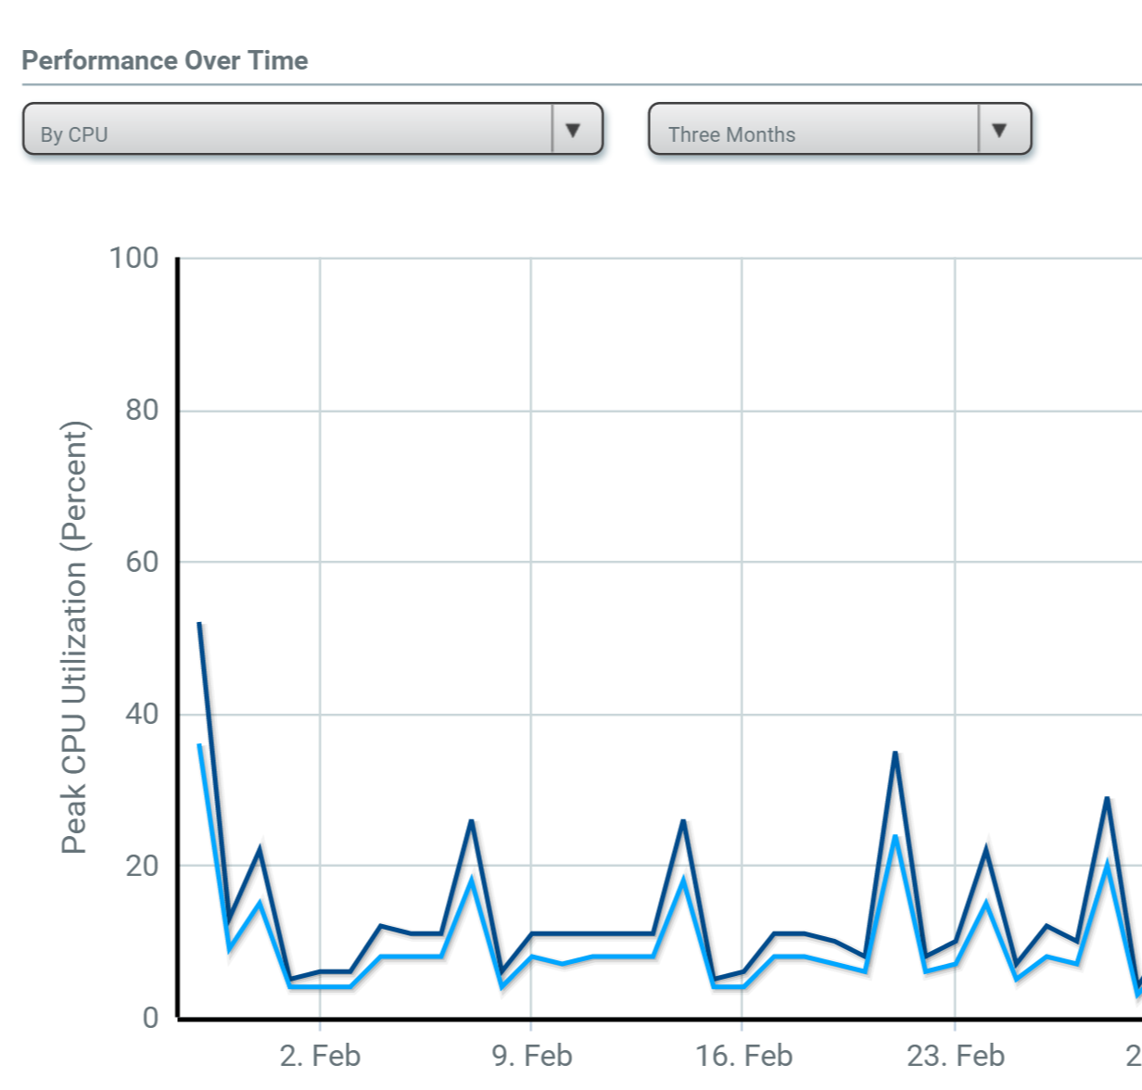
THE CLOUD JOURNEY
Assess
Get precise TCO for Azure
Identify your best fit configuration
See projected performance with recommended cloud configuration

Slide 7
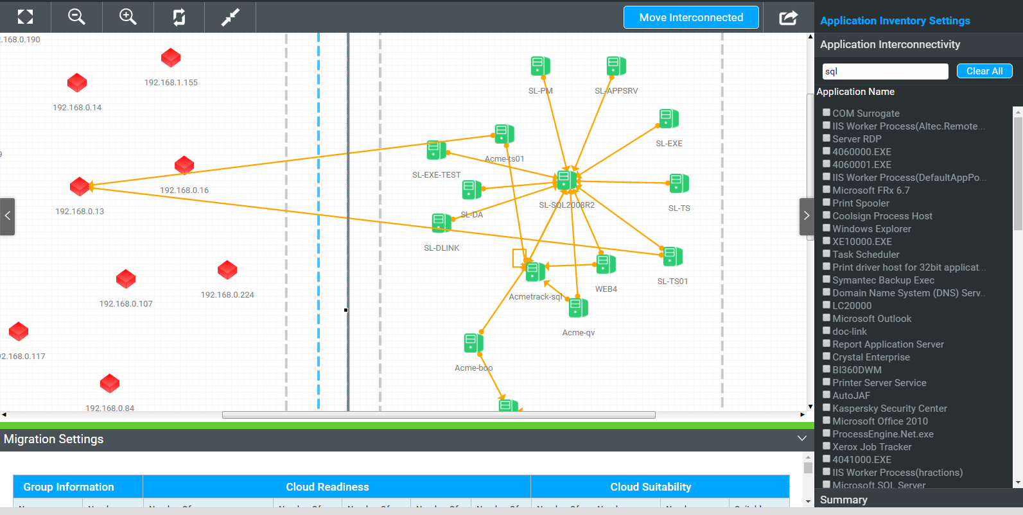
THE CLOUD JOURNEY
Plan
Discover your infrastructure
Map application dependencies
Build move groups and design your migration plan
Identify optimal cloud configuration for each workload to migrate to

Slide 8
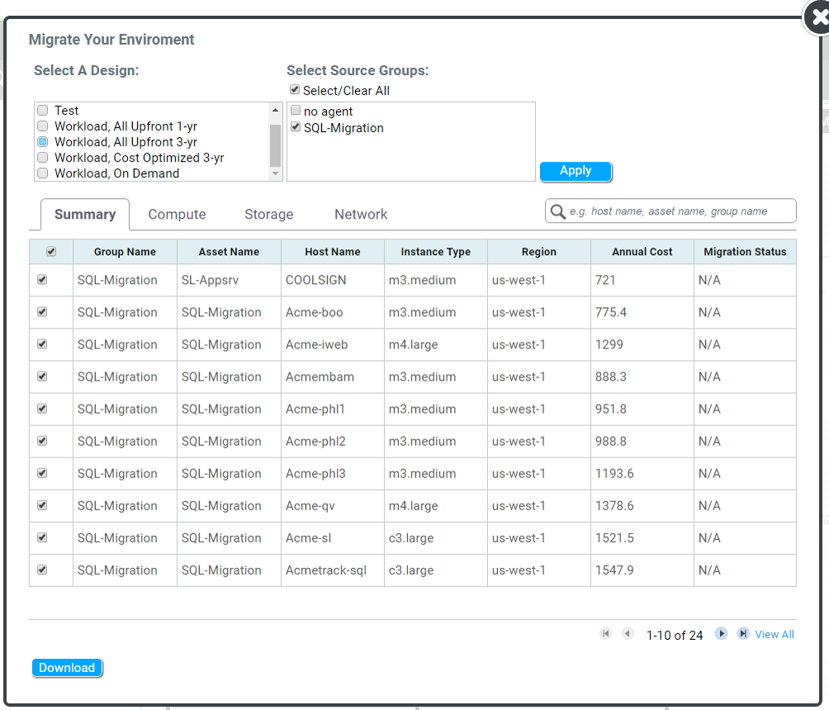
THE CLOUD JOURNEY
Migrate
Import your migration plan to ASR
View ASR Readiness Reports
Migrate workloads to Azure

Slide 9
THE CLOUD JOURNEY
Validate
Visualize connectivity between infrastructures
Compare new state to historical state
Validate application dependency

Slide 10
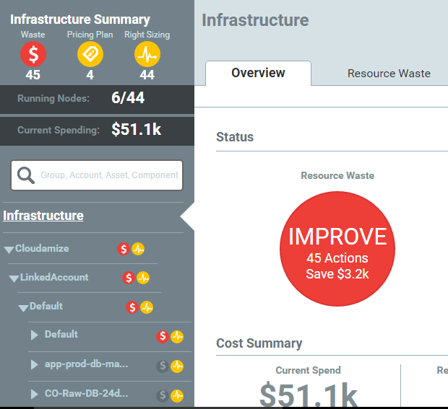
THE CLOUD JOURNEY
Manage
Right-size cloud workloads
Accurately plan capacity
Analyze costs, filter billing data, and build chargebacks

Slide 11
Value Drivers

Slide 12
Key Benefits of Cloudamize
Achieve your optimal cloud environment
Control and lower cloud costs
More quickly make accurate cloud decisions
Accelerate time to cloud value

Slide 13
Key Benefits to Partners
Remove sales friction at the TCO conversations level
Increase close rate by having data-driven sales cycle
Reduce time to migrate to the cloud
Scale migration team by enabling PS/SIs on a single platform
Increase retention by helping customer realize promise of the cloud
Build and scale managed services business by providing services on top of Cloudamize Platform.

Slide 14








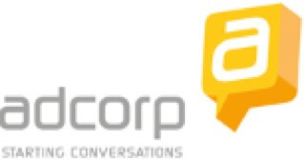








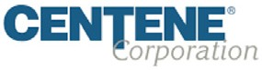
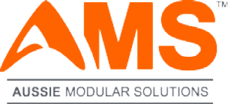



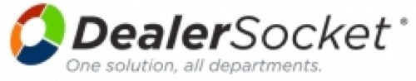


































Slide 15
Value Delivered
500+ assessments
65% - 80% average reduction in planning time
48% average cost savings
$75mm estimated savings

Slide 16
Case Studies

Slide 17
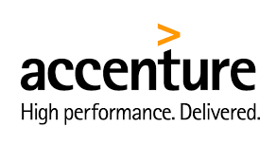
Customer Reference
Cloudamize reduces enterprise’s app migration cycle by over 75%
Background
In the previous year, Accenture’s IT group began a migration of several internal datacenters to the public cloud
Accenture spent nearly 6 months manually analyzing how to optimize the mapping of on-premise infrastructure to the cloud
The migration planning proved to be highly challenging and led to delays in the migration execution
Challenge
We want to migrate ~1600 nodes and ~500 applications to either AWS or Azure. How do we rapidly determine the right-sized cloud configuration to ensure that workload performance doesn’t suffer and get the final migration settings to move workloads to AWS and Azure?
Accenture decided to evaluate multiple tools and ultimately picked Cloudamize to help during migration planning.
Solution
Impact
Accenture IT leveraged Cloudamize to build a more automated process for migrating to the cloud, shortening the migration cycle for a typical application from 3 months to 3 weeks relative to the previous approach
Prior to adopting Cloudamize, Accenture IT used a highly manual approach, relying on workshops with application owners to map out dependencies and an internal tool to determine the configuration of cloud machines
17

Slide 18

Challenge With two data centers, 840 servers, and 180 applications, Brookfield was challenged to understand how much it would cost to move to Azure, and how it could efficiently build a migration plan.
Solution Leveraged Cloudamize to understand the cost of its right-sized environment in Cloudamize and to quickly build move groups for migration.
Results Brookfield signed an Azure contract for a $2.5 M annual Azure subscription within 2 months of using Cloudamize.

Slide 19
How It Works

Slide 20
Analytics Engine

Slide 21
Data Collection

Slide 22
Data Collection Method
Infrastructure | Data Collection Options
VMware | Hypervisor via Cloudamize Proxy, agent, and agent-less
Hyper-V | Agent on Hyper-V host, agent on individual VMs, and agent-less
Windows Physical Machine | Agent and agent-less
Linux Physical Machine | Agent and agent-less
Cloud Instances | Agent and agent-less

Slide 23
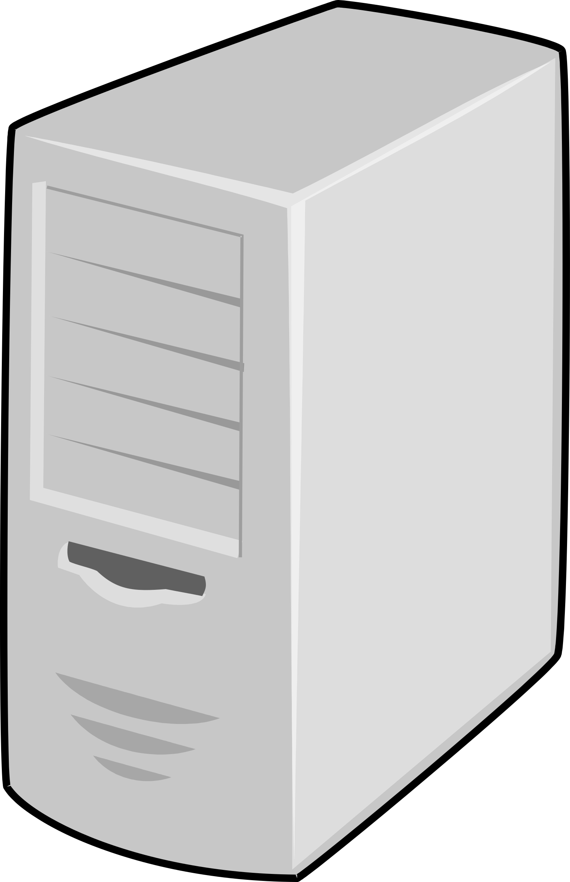
Cloudamize Agents Data Flow
Firewall
VPN 1
Physical Machine
Virtual Machine
Outbound 80 or 8080 / 443 (TLS 1.2)
Outbound 443 (TLS 1.2)
VPN 2
Corporate Proxy
Cloudamize Server
Physical Machine
Virtual Machine

Slide 24
Cloudamize Agent-less Data Flow
Firewall
Subnet 1
Outbound 80 or 8080 / 443 (TLS 1.2)
Inbound SSH / WMI
Physical Machine
Virtual Machine
Cloudamize Agentless Data Collector 1
Outbound 443 (TLS 1.2)
Subnet 2
Corporate Proxy
Inbound SSH / WMI
Cloudamize Server
Physical Machine
Virtual Machine
Outbound 80 or 8080 / 443 (TLS 1.2)
Cloudamize Agentless Data Collector 2

Slide 25
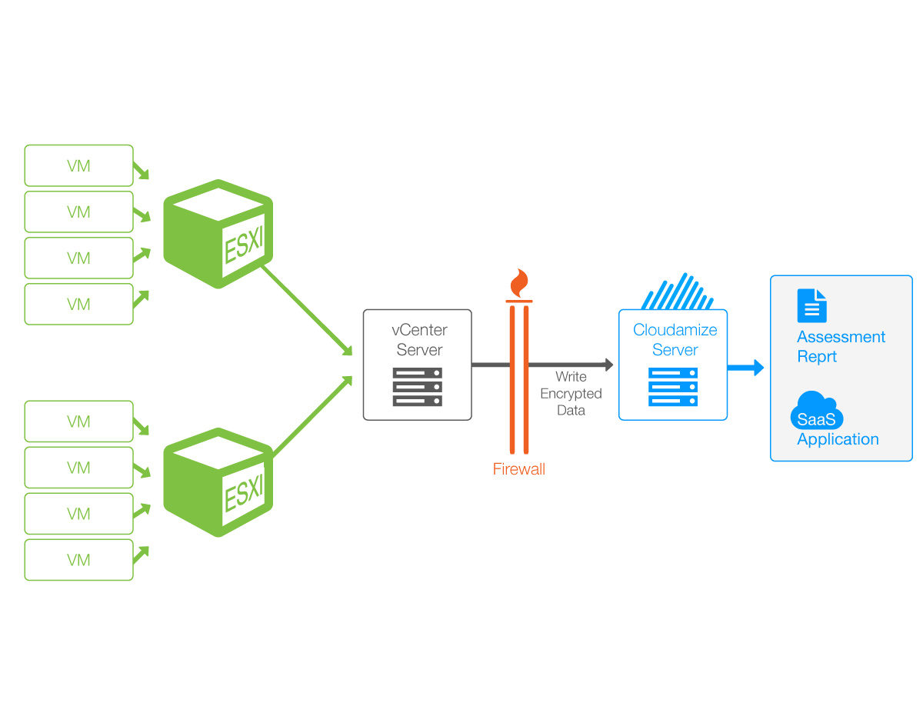
vCenter FAQ
Read-only credentials must be created for each vCenter
Data travels via Cloudamize Proxy which can be installed either directly on the vCenter machine or different VM
The Cloudamize Proxy is unique to each vCenter
The proxy communicates on 443 to IP 184.73.183.154

Slide 26
Agent-less vs Agent-based
Class | Agent-based | Agent-less
Data Collection Method | Light-weight software on each end-point | SSH, WMI
Security Protection | Traffic is encrypted via SSL between endpoints and the Cloudamize server with mutual end-point authentication. | Ports will be open between the agent-less data collector and all endpoints on the subnet. Data is sent from the collector to the Cloudamize servers and is encrypted via SSL.
Deployment Model | Agents must be installed on physical and virtual machines as well as Hyper-V hosts. The agent can easily be pushed out via Active Directory, chef, puppet, SCCM, etc. | WMI services for each Windows endpoint and SSH will need to be configured for each Linux endpoint. One machine/VM will need to have the agentless data collector installed.
Ease of Deployment | A single outbound port (TCP 443) to a 104.197.11.97 is required. Generally this port is already open and no changes are needed. | Agentless Data collector installed locally on one machine per subnet. Ports 135, 445, and 1024-65535 will need to be open inbound on all Windows endpoints, and open outbound on the machine with the data collector installed. Port 22 will need to be open inbound on all Linux endpoints. The machine with the data collector installed will communicate outbound on 443 to Cloudamize IP 184.73.183.154.
Resource Consumption | Data collection occurs locally and compressed data is sent over the internet. Data collection is halted if CPU and memory thresholds are crossed. For example, CPU is throttled at 2%. | Increases network traffic as the raw performance data is transported over the network to a remote data collector. No throttling mechanism available on the end points.
Accuracy | High frequency collection of performance metrics. Discovers all applications and their dependencies in detail. | Lower frequency data collection results in less accuracy and not all application dependencies are captured.
Scalability | Agent handles process initiation and stream handling making this very easy to scale. | Server must handle process initiation and stream handling resulting in a limit to how many connections can be handled concurrently. Agent-less Data collector can handle 500 endpoints per collector.
Robustness | Caching mechanism is available in the event of network disruption for added robustness. | Network connectivity issues can impact data collection.

Slide 27
Feature Comparison- Application Discovery and Migration Planning
Features | Agent Based | Agent-less
Application Discovery | Yes | Yes
Application Dependency Mapping | Yes | Yes
Auto-grouping applications based on business rules and affinity mapping | Yes | Yes
Inter and Intra dependency analysis | Yes | Yes
Cloud Readiness Analysis | Yes | Yes
Cloud Suitability Analysis | Yes | Yes
Migration Group Builder | Yes. | Yes
Shadow IT Identification | Yes | Yes
Firewall Rules Generation | Yes | Yes

Slide 28
Feature Comparison- Right-Sizing and TCO
Features (TCO) | Agent Based | Agent-less
TCO Projection for move groups | Yes | Yes
Right-sizing based on performance profiles (compute, storage, network) | Yes | Yes
Projection Analysis (see current and projected cloud performance) | Yes | Yes
Planning and Forecasting – ability to build custom designs based on the need | Yes | Yes
Pre-build TCO Reports | Yes | Yes

Slide 29
Missing Features in Agent-less Approach
Metric | Impact
Short-lived connections | If the connections short-lived they are not captured and that may result in missed inter-connectivity
Lower performance resolutions | Monitoring window is at every 5 min rather than every 30-seconds. Likely to loose short-term peaks
DNS traffic and analysis | Mapping between IP address and DNS is not available
Installed list of applications | List of installed applications and their CPU Usage will not be collected
SQL Editions | Cost analysis will not include SQL editions and mapping
.NET version | Limited ASR compatibility analysis
Performance Throttling | Agentless-monitoring does not have performance controlling mechanism on the monitored host

Slide 30
Supported Systems
Supported Window OSs
Windows Server 2016
Windows Server 2012 R2
Windows Server 2012
Windows Server 2008 R2
Windows Server 2008
Windows Server 2003 R2
Windows Server 2003
Supported Linux OSs
Red Hat Enterprise Linux Server release 5.0 or higher
Ubuntu 10.04 or higher
CentOS release 5 or higher
Debian GNU/Linux 6.0 or higher
Amazon Linux AMI release 2013.03 or higher
Fedora release 12 or higher
Suse Linux 11 or higher
Oracle Linux 6.5 or higher
Chipsets
Intel xeon
AMD Opteron
Pentium 4
Pentium D
Pentium M
Some Intel core 2
*Typically desktop and laptop processors are not supported since they are not considered candidates to move to the cloud.

Slide 31
Deploy Cloudamize vs Manual approach
Manual approach
Generally start w/ incomplete CMDB
Have to fill in gaps w/ interviews
Create pivot tables and Vizio diagrams to make sense of and visualize data
Time and resource intensive for both partners and clients (can take months)
High likelihood of inaccuracies
Cloudamize
In most cases, no changes to firewall policy is needed so no issues with security change policy there.
Business policies of software (agent) change management is applied so it can take up to a week to install everywhere.
Quicker due to having all the necessary metrics at your finger tips
User interface enables building move groups based on specific criteria and TCO of that group enabling faster migration roadmap

Slide 32
Supported Infrastructure

Slide 33
Supported Systems
Supported Window OSs
Windows Server 2016
Windows Server 2012 R2
Windows Server 2012
Windows Server 2008 R2
Windows Server 2008
Windows Server 2003 R2
Windows Server 2003
Supported Linux OSs
Red Hat Enterprise Linux Server release 5.0 or higher
Ubuntu 10.04 or higher
CentOS release 5 or higher
Debian GNU/Linux 6.0 or higher
Amazon Linux AMI release 2013.03 or higher
Fedora release 12 or higher
Suse Linux 11 or higher
Oracle Linux 6.5 or higher
Chipsets
Intel xeon
AMD Opteron
Pentium 4
Pentium D
Pentium M
Some Intel core 2
*Typically desktop and laptop processors are not supported since they are not considered candidates to move to the cloud.

Slide 34
Demo

Slide 35
Partner Process and Timeline
Total 32 Days
2 Days
3 Days
14 Days
3 Days
3 Days
7 Days
1
2
3
4
5
6
7
Discussion on Business Drivers and Assessment Scope
Start Assessment
Working Session with Client to Revise Plan
Execute Migration Plan Using ASR
Install Cloudamize Software
Review Results and Build Initial Plan
Present/Finalize Migration Plan

Slide 36
Discussion on Business Drivers and Assessment Scope
1
2
3
4
5
6
7

Slide 37
Initial Conversations / Business Drivers
Internal drivers - management / business units driving Azure adoption
Hardware refresh or EOL for hardware
Environment preferences e.g. DR, Production, Location
Business policy/ Security/Compliance concerns that may not allow specific workloads to move to Azure
Benefits from Azure
E.g. agility, elasticity, cost savings via auto scaling, automation, chargeback.
Budget constraints
Internal success metrics

Slide 38
Install Cloudamize Software
1
2
3
4
5
6
7

Slide 39
Set Up Infrastructure
Select Infrastructure
Add VMWare vCenter
Install Agents
VMware
Hyper-V
On-Premise
Linux
Windows
Create read-only credentials
Open outbound port 443
Install Cloudamize proxy
Linux
Command line
via Proxy
HyperV Host/Windows
Command line
via Proxy

Slide 40
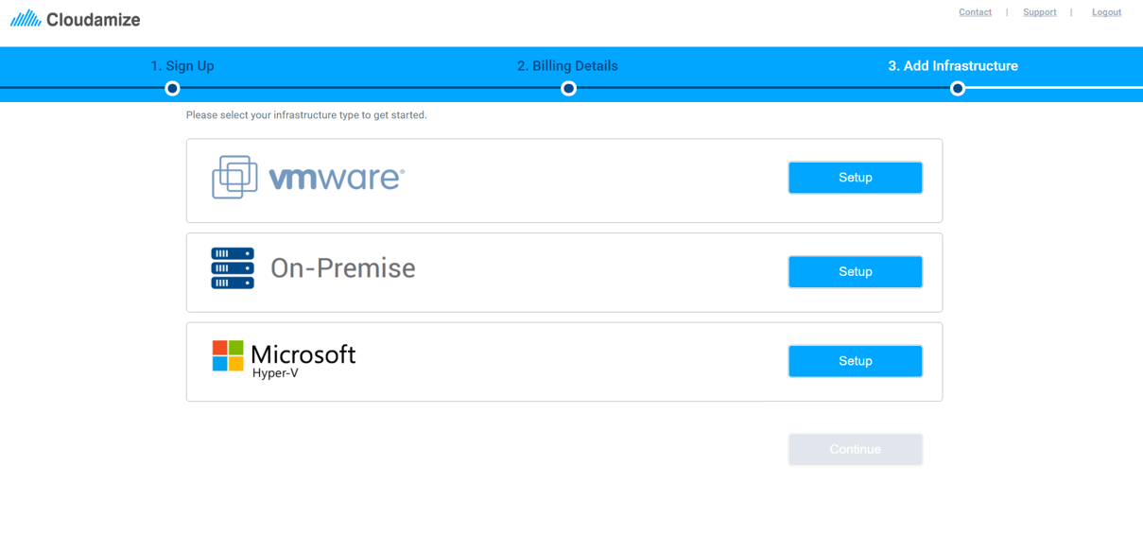
Select Infrastructure

Slide 41
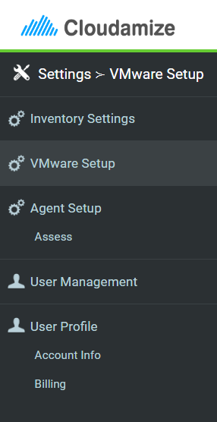
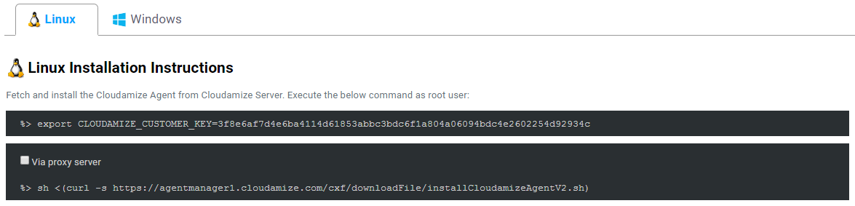
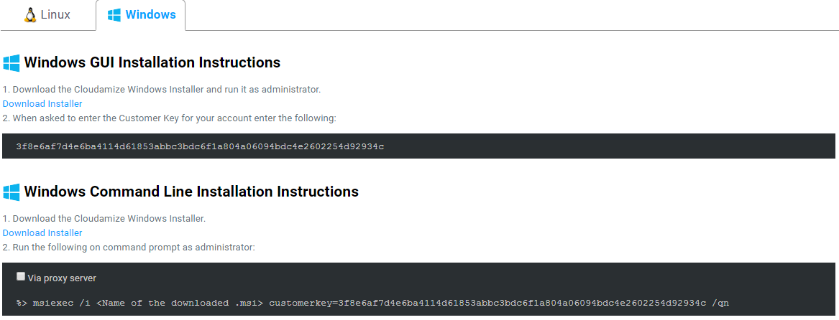
Install Agents / Configure VMware

Slide 42
Agent Installation: vCenter

Slide 43
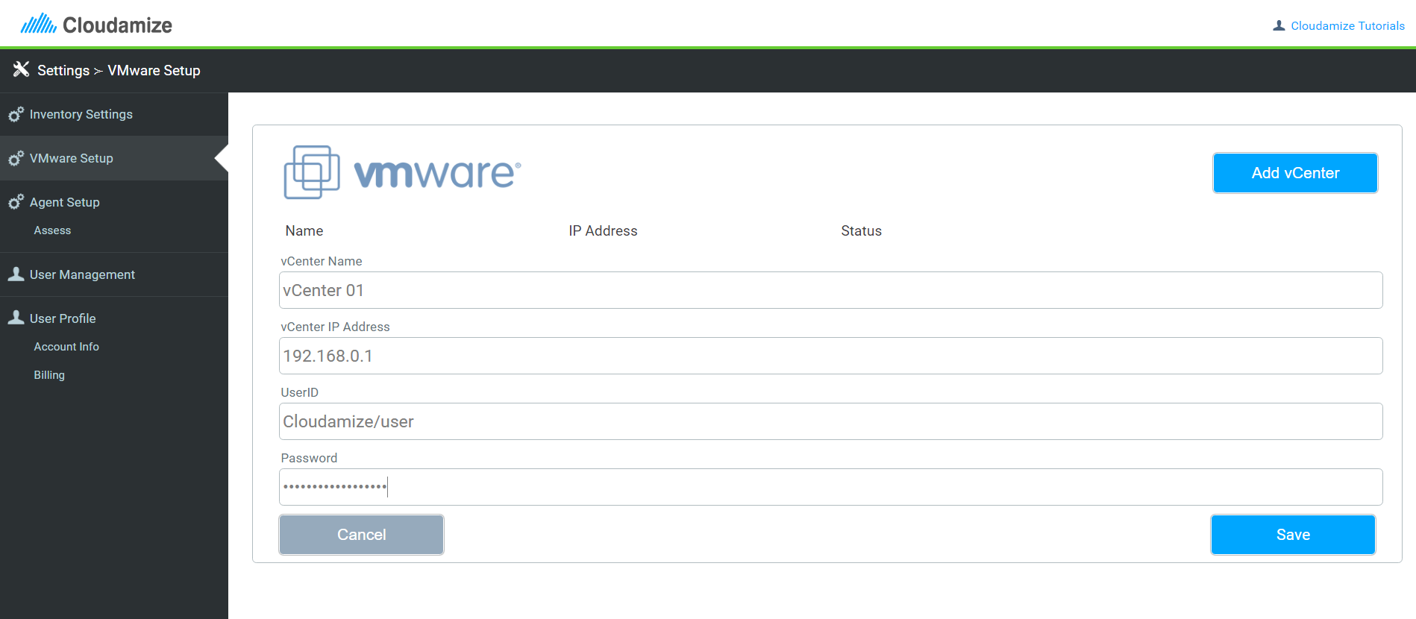
Add vCenter
Create read-only credentials for Cloudamize application. View the Cloudamize Tutorial here.

Slide 44
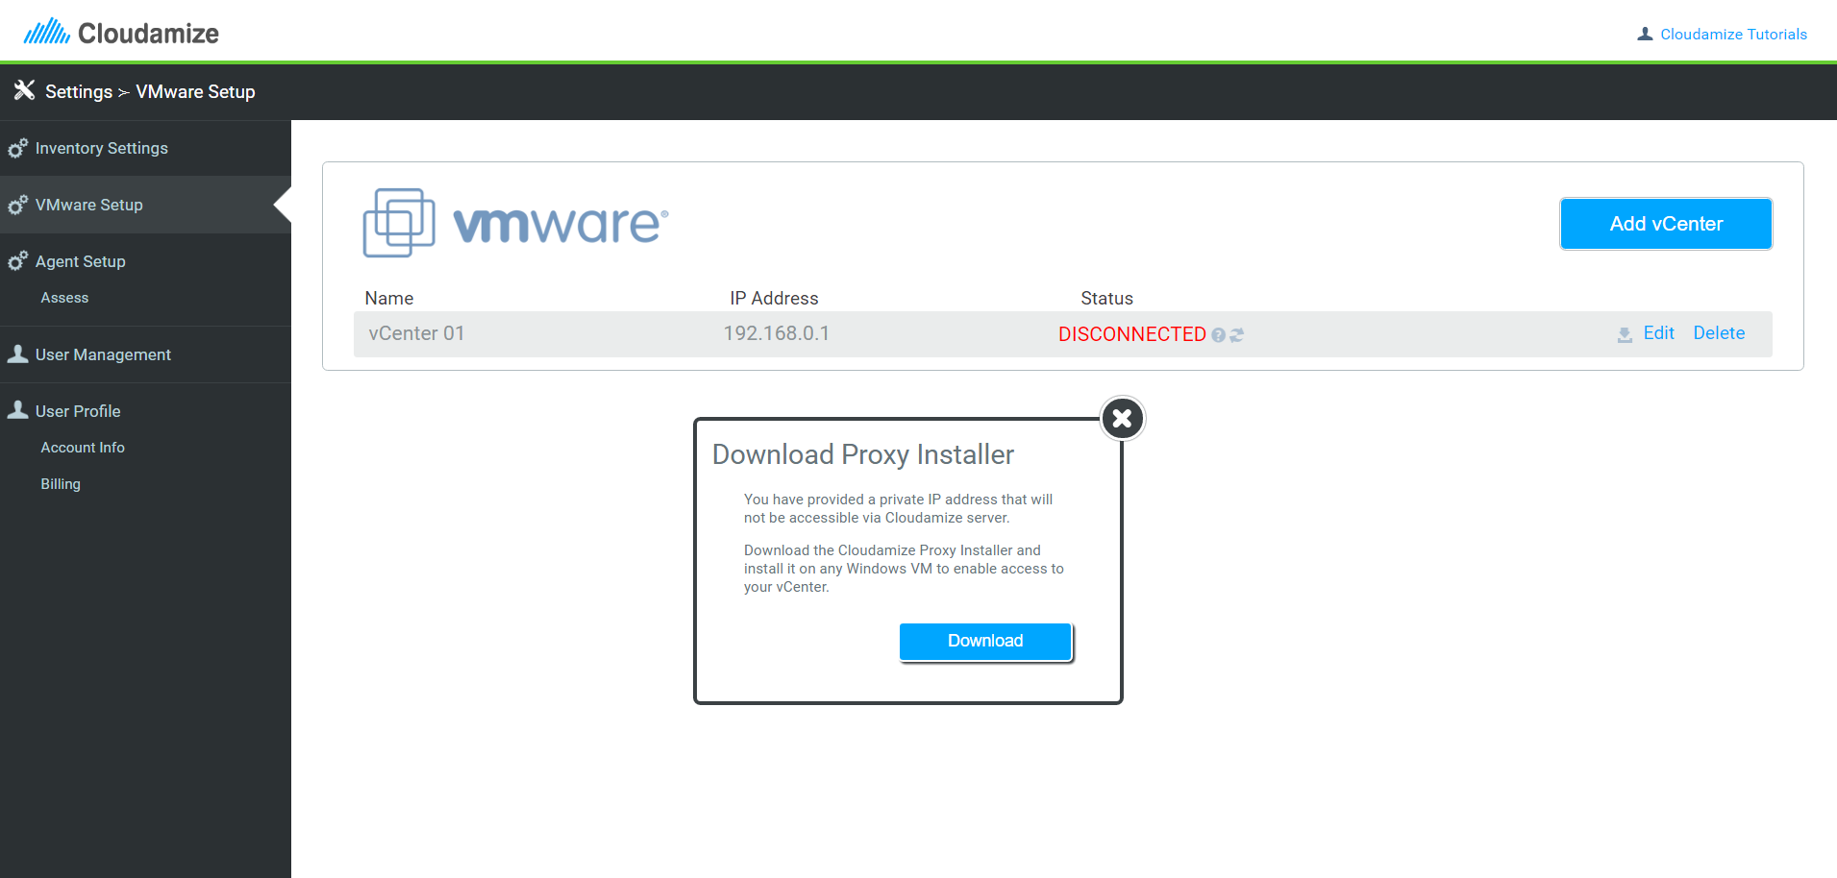
Install vCenter Proxy
Cloudamize Proxy will need to be installed on a Windows VM to route the traffic to Cloudamize Server.
View the Cloudamize Tutorial here.

Slide 45
How Does the vCenter Proxy Work?
Windows VM
or
vCenter NM
Cloudamize Proxy
Cloudamize
Server
SSL Port 443
SSL Port 443
The proxy can be installed either directly on the vCenter machine or on a separate Windows virtual machine.
The proxy is unique per vCenter and VM, if you have two vCenters, you will need two unique proxies installed
View the Cloudamize tutorial here.

Slide 46
Agent Installation: HyperV / Windows

Slide 47
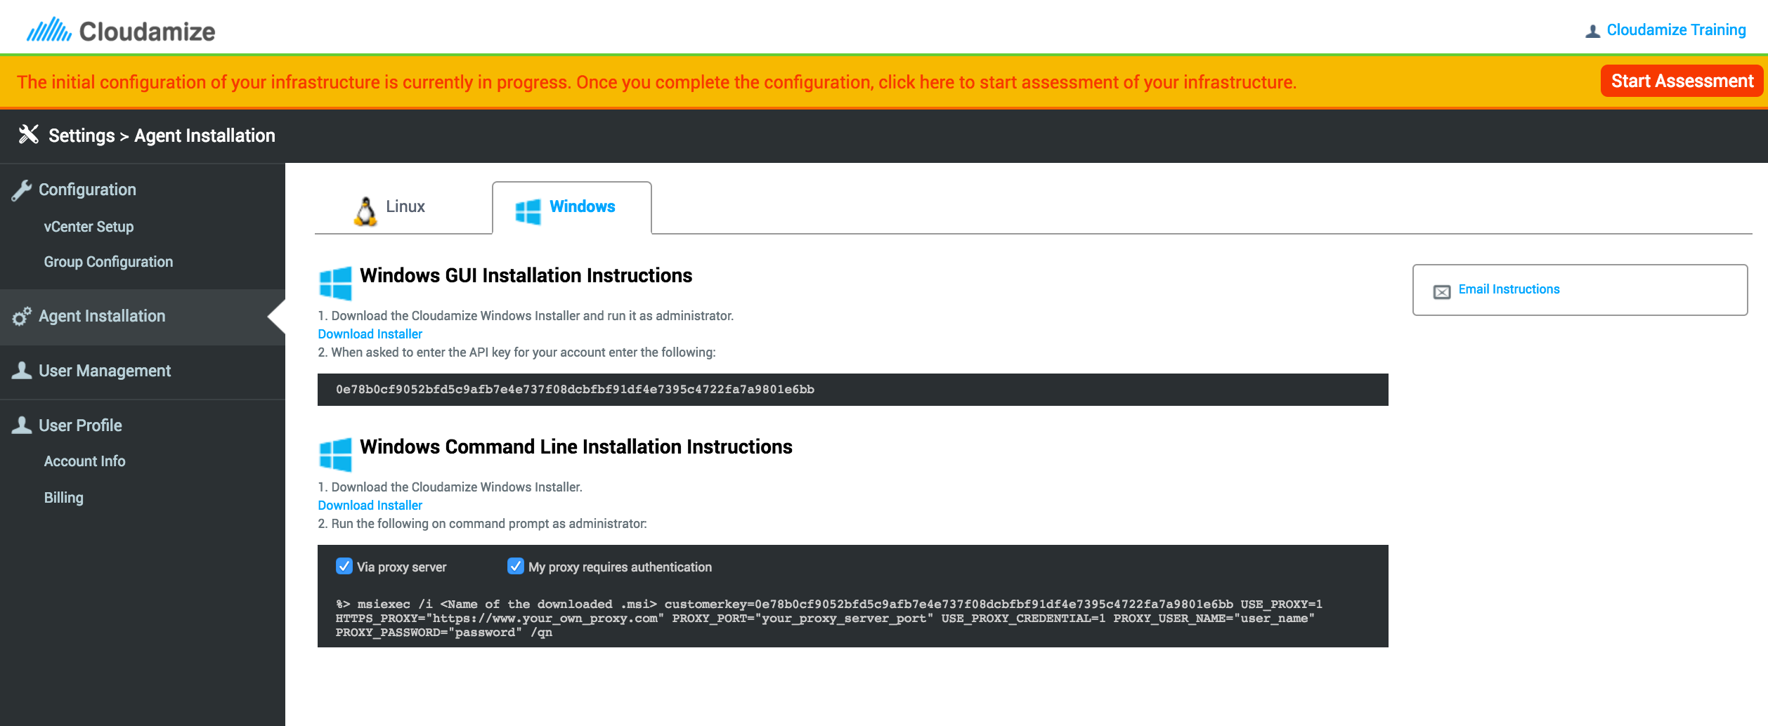
Add HyperV/Windows Agent
Export your customer key and install an agent
Outbound firewall over SSL/443 port
Data can be routed via internet proxy
View the Cloudamize Tutorial here.

Slide 48
Agent Installation: Linux

Slide 49
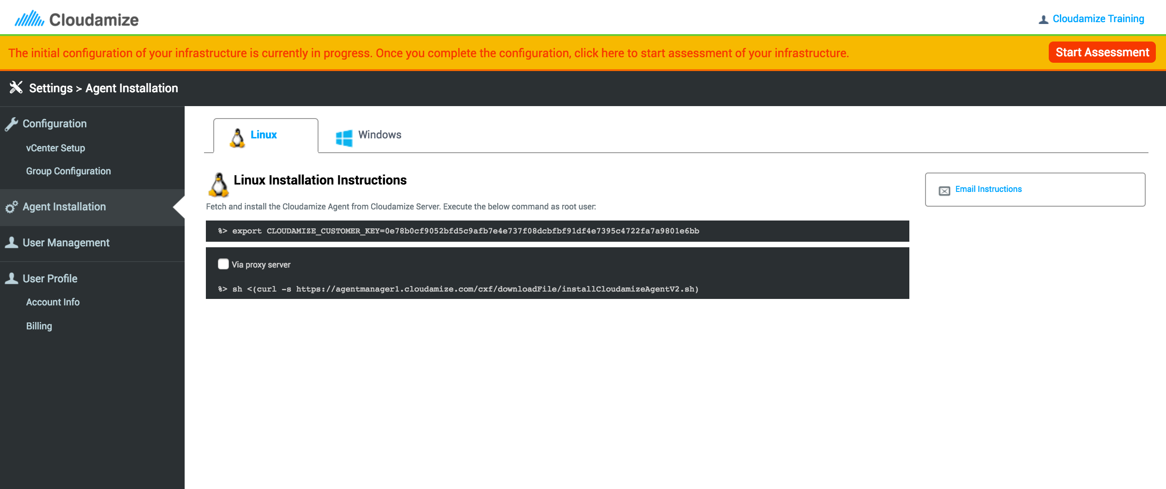
Add Linux Agent
Export your customer key and install an agent
Outbound firewall over SSL/443 port
Data can be routed via internet proxy
View the Cloudamize tutorial here.

Slide 50
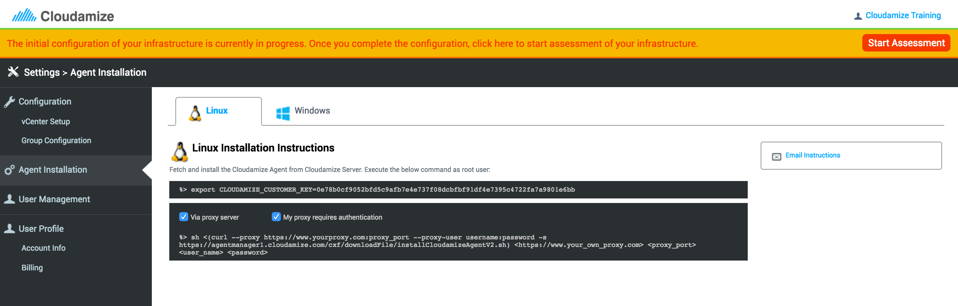
Route Agent Traffic via Internet Proxy
View the Cloudamize Tutorial here.

Slide 51
Agentless Installation

Slide 52
Minimum Hardware Requirements for Agentless Collector (up to 500 hosts)
64 bit OS
.NET 4.0
4 CPU Cores
5GB RAM
2GB HDD

Slide 53
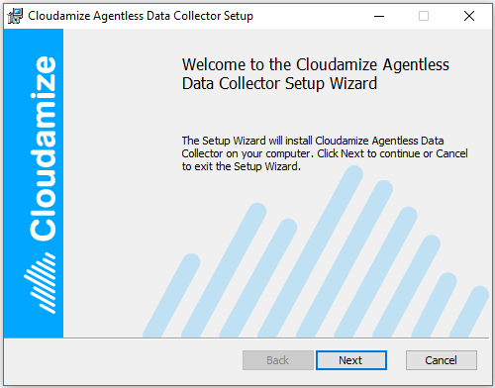
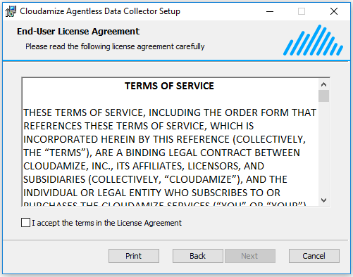
Cloudamize Agentless Data Collector: Setup

Slide 54
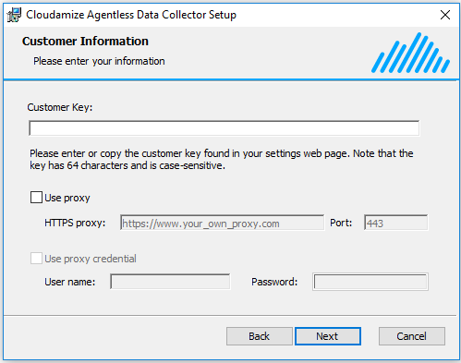
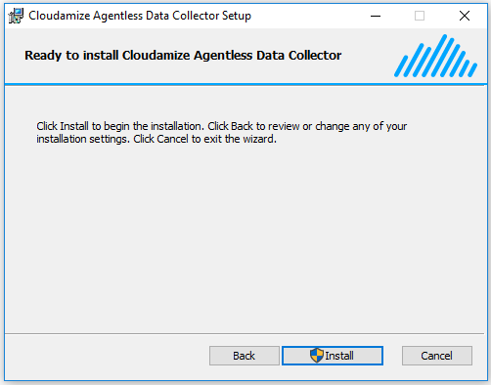
Cloudamize Agentless Data Collector: Setup

Slide 55
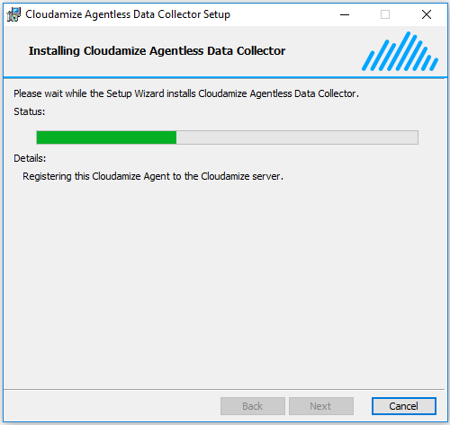
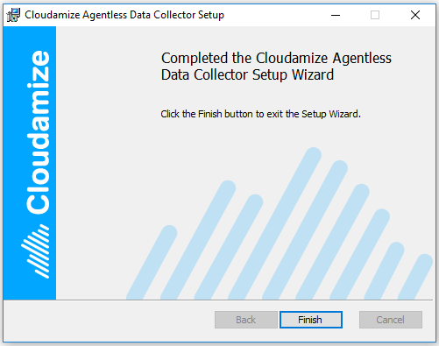
Cloudamize Agentless Data Collector: Setup

Slide 56
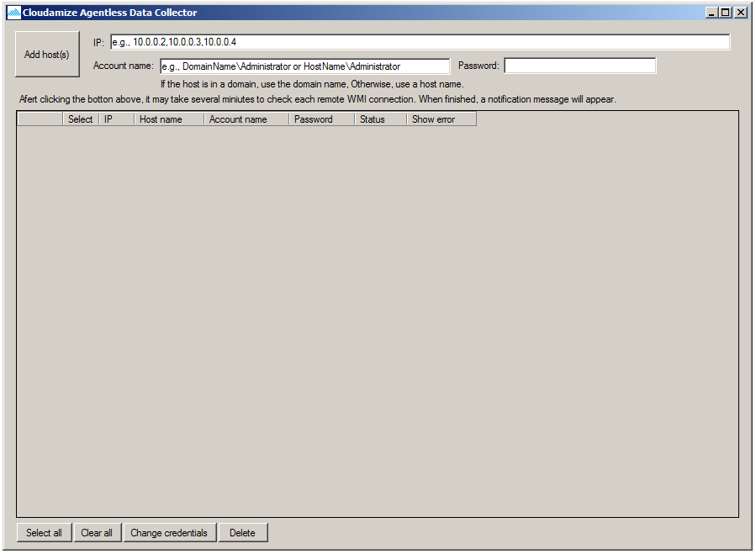
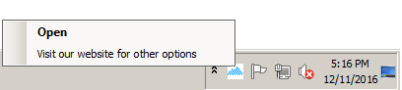
Cloudamize Agentless Data Collector: Launch
Launch Cloudamize Agentless Data Collector
Cloudamize Agentless Data Collector UI
2. Click to open Cloudamize Portal
1. Right click or double click on the tray icon to open UI

Slide 57
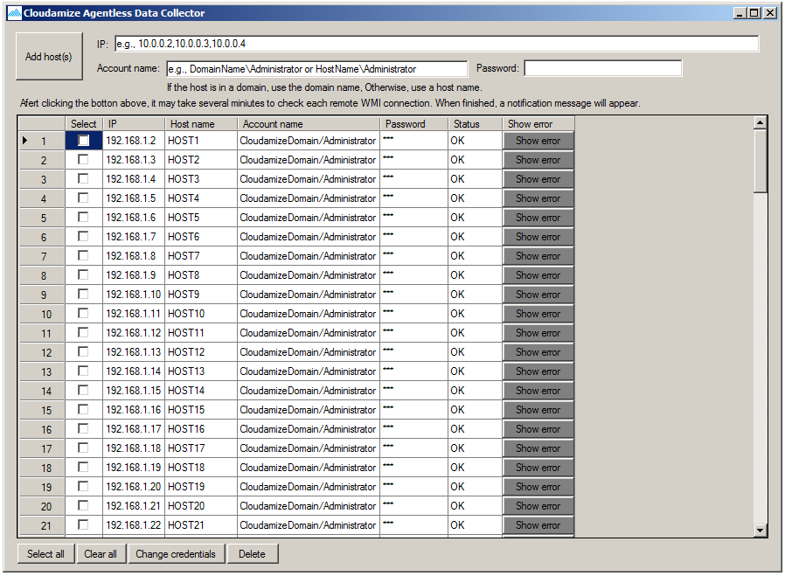
Configure Agentless Data Collection
1. Add Hosts
2. Select a host
3. Change credentials

Slide 58
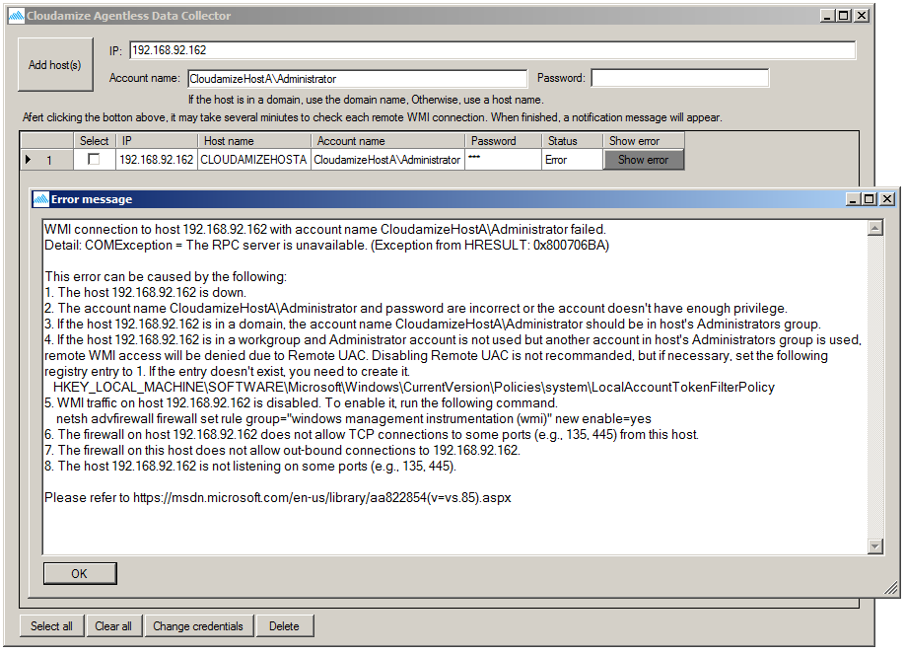
Identify Errors and Expedite Setup
Click this button to see an error message
Note that if a remote WMI connection fails after clicking ‘Add host(s)’ button or when changing credentials, this message will be popped up. This will allow customers to quickly debug infrastructure issues and commence data collection.

Slide 59
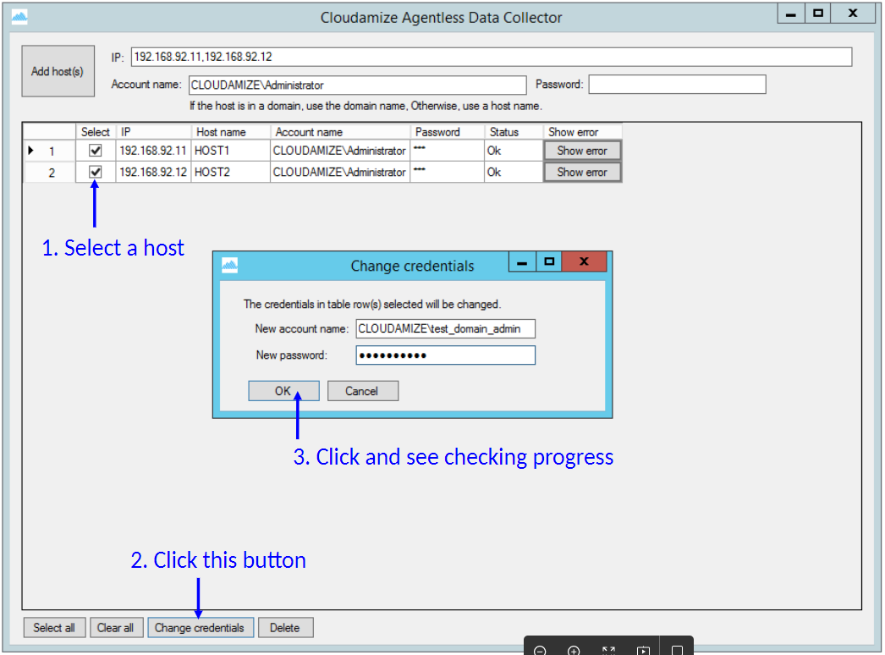
Change Credentials

Slide 60
Interpreting Configuration

Slide 61
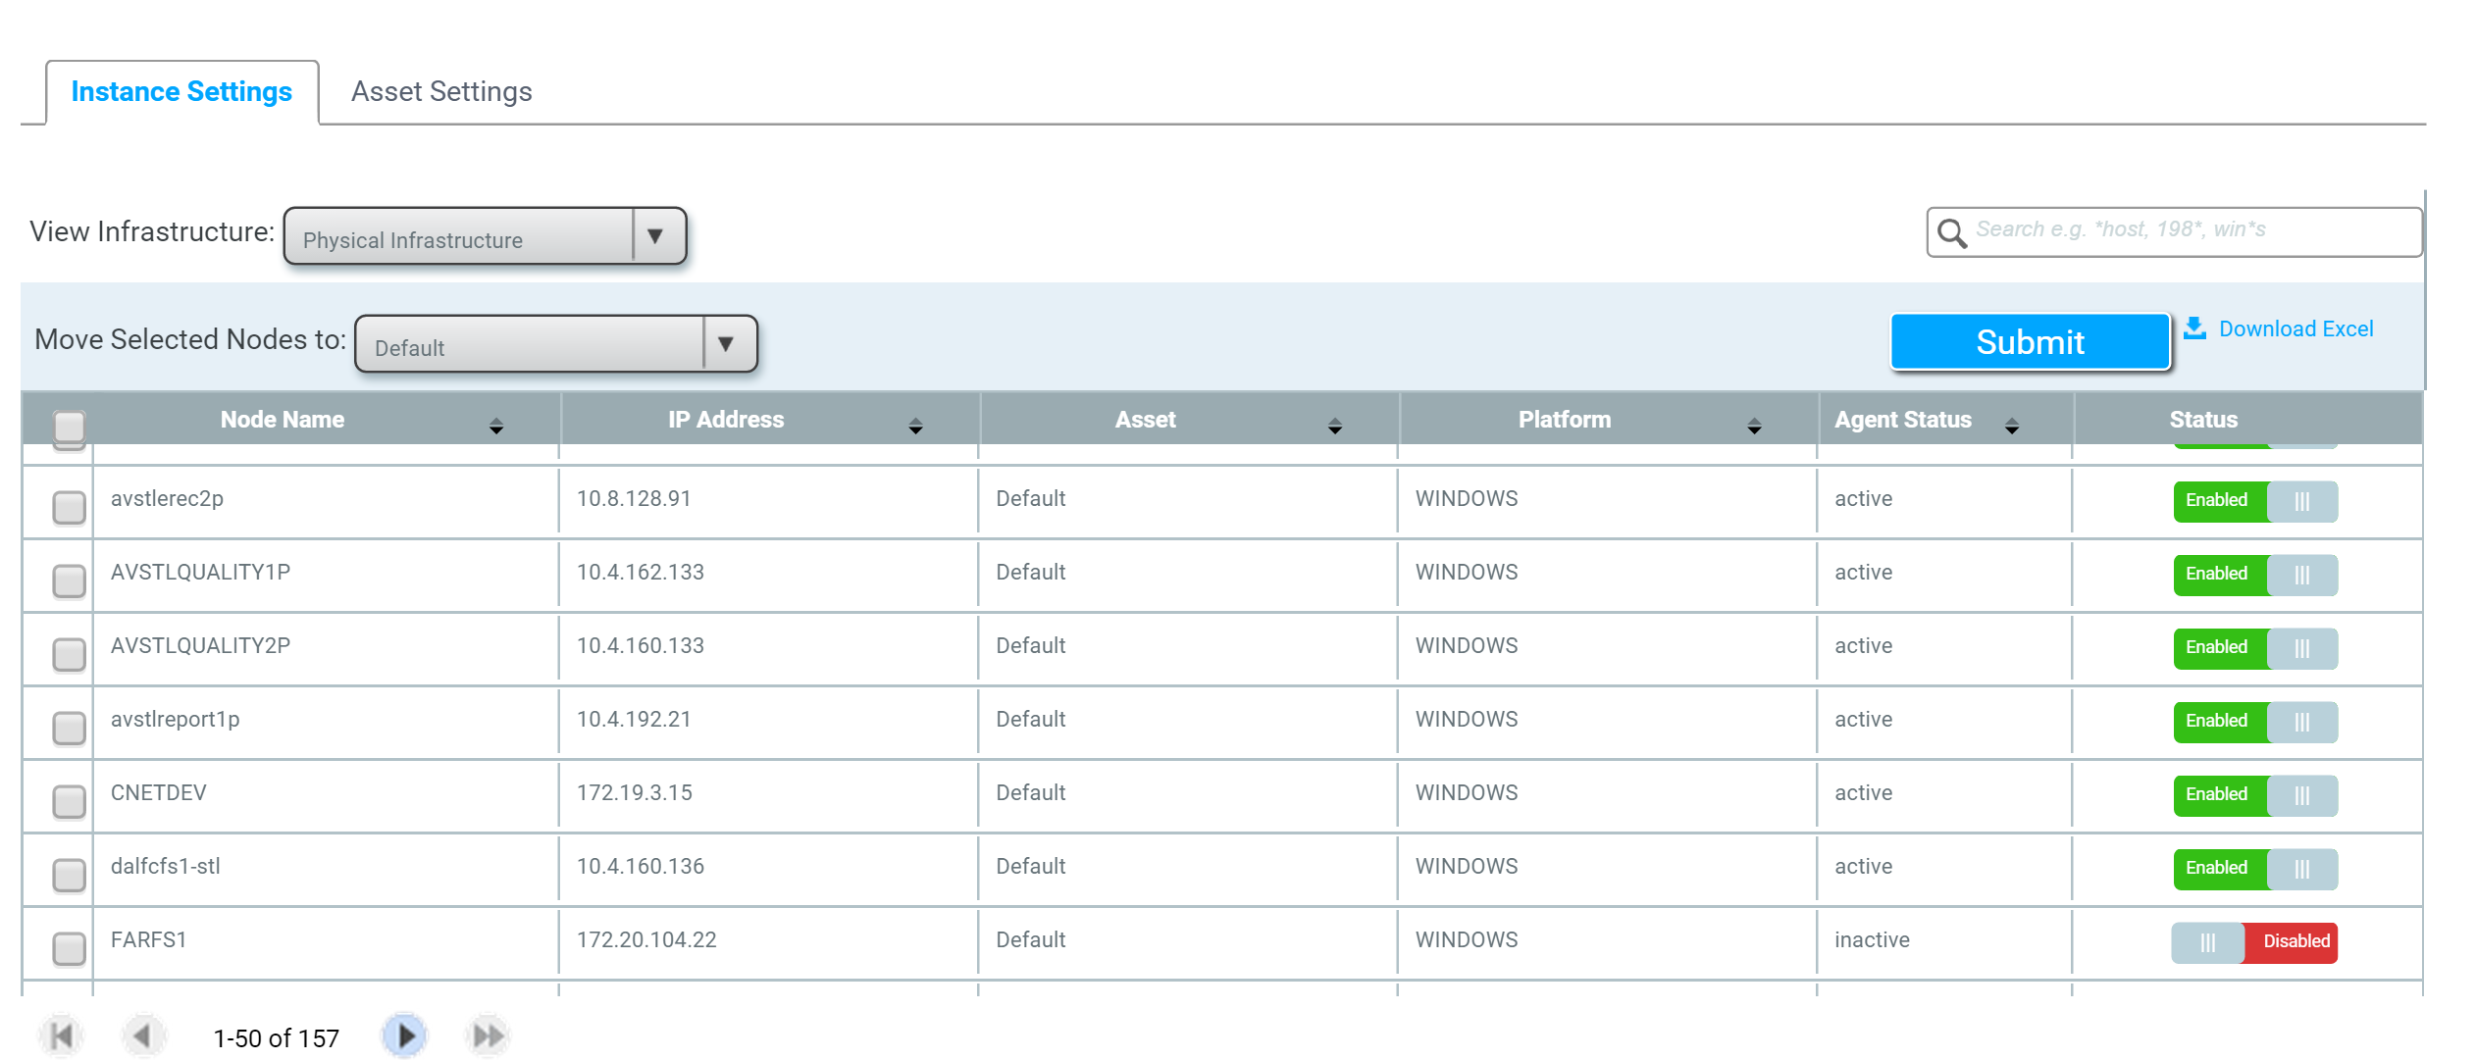
Monitor Data Collection
As the installation occurs, the nodes will appear on within few minutes at Settings -> Group Configuration -> Instance Settings
You can disable the nodes you do not wish to assess using “Enable/Disable” button

Slide 62
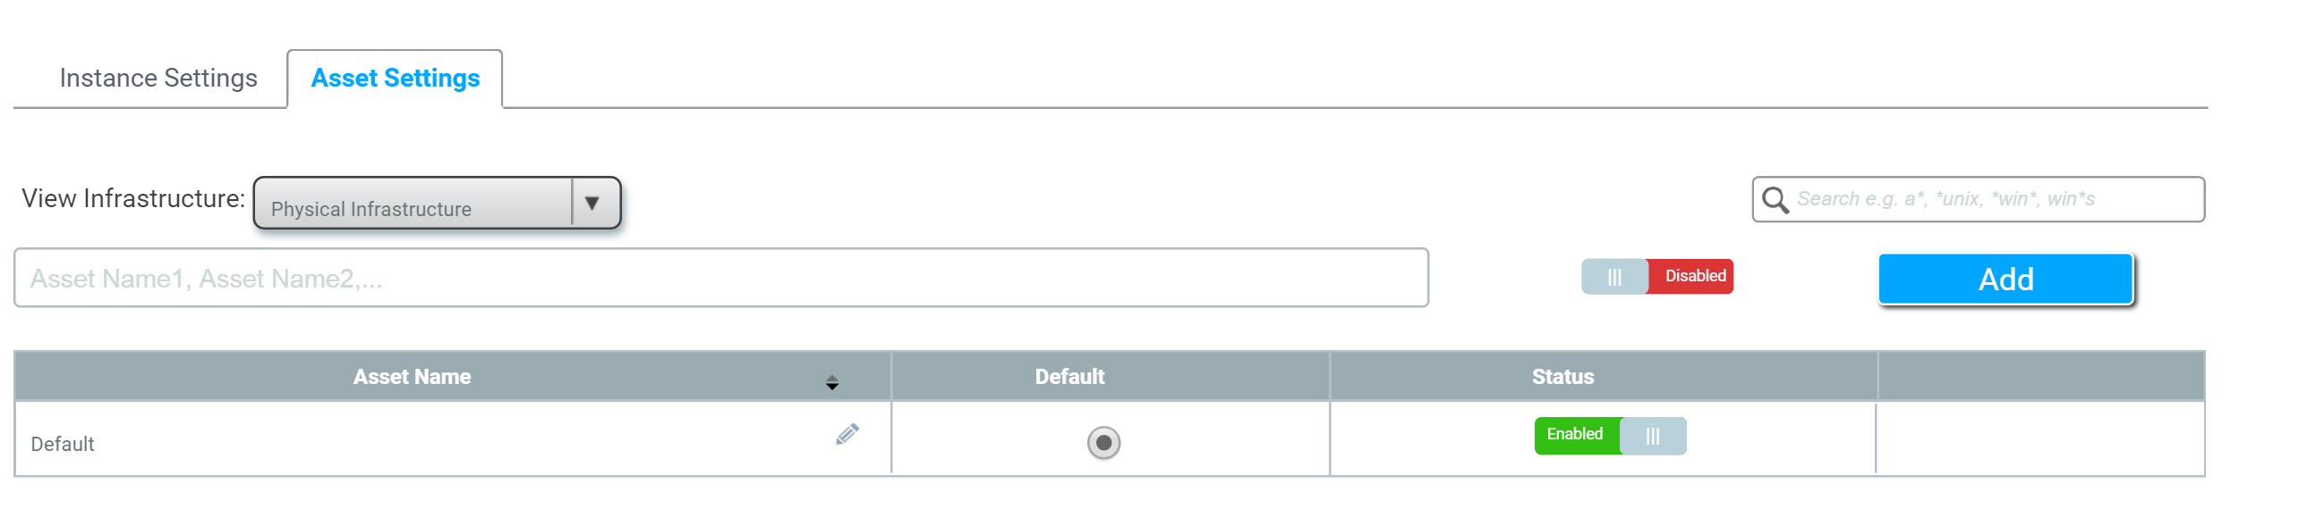
Create Asset Groups
Group nodes into Assets to understand assessment and cost per group.

Slide 63
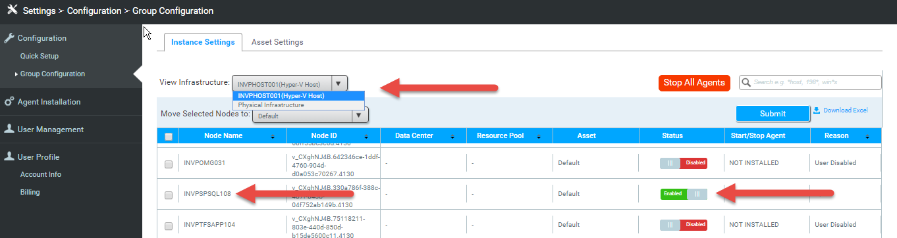
Interpreting Assess / Configure Plan
Note in the screenshot that the node “SQL108” appears under the Hyper-V host and is enabled
This shows that we are collecting the system-level data necessary for Assess
View the Cloudamize Tutorial here.

Slide 64
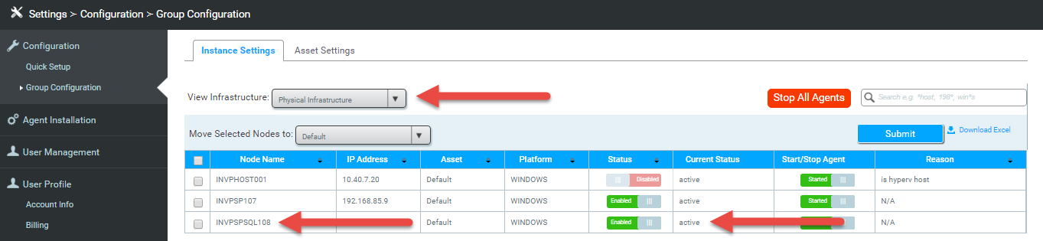
Interpreting Assess / Configure Plan
Here we see that in the node “SQL108” also appears under “Physical Infrastructure”
This shows that we are also collecting the application-level data necessary for Plan
View the Cloudamize Tutorial here.

Slide 65
Start Assessment
1
2
3
4
5
6
7

Slide 66
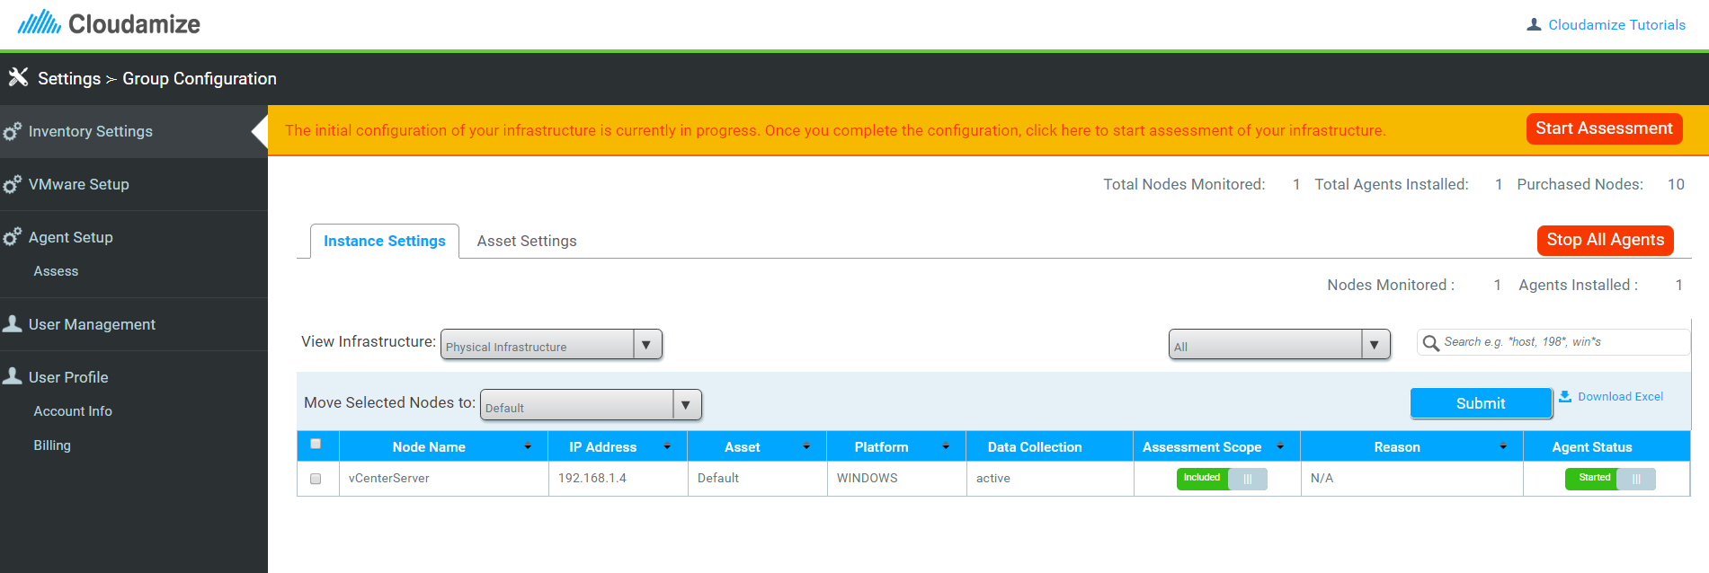
Start Assessment
Click here once ready to begin the assessment.
Check each view to ensure infrastructure is setup correctly.
Include all of the nodes that are desired for the assessment and exclude everything else.

Slide 67
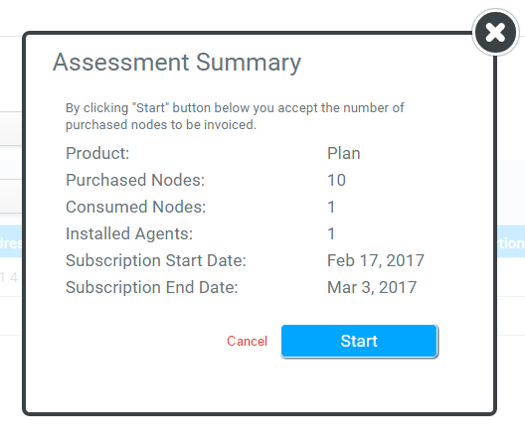
Confirm Assessment Summary
Review and confirm your assessment details before continuing.
Click “Start” to continue.
Option to cancel and return to configuration settings.

Slide 68
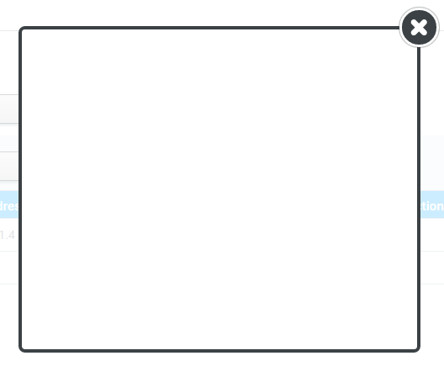
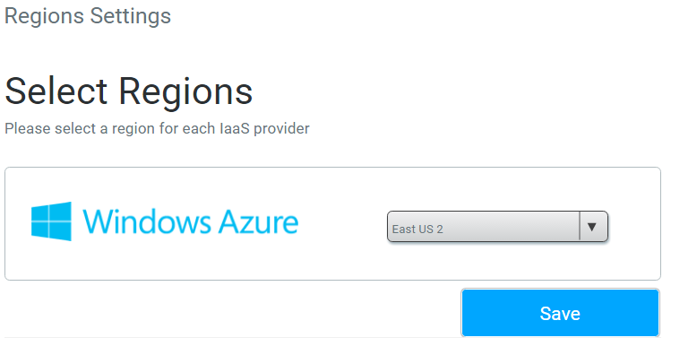
User Region Selection
Select Region that the assessment will be mapped to.
Click save to start the assessment

Slide 69
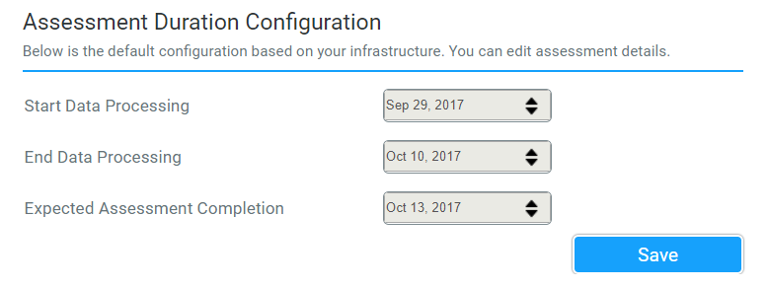
Select Assessment Dates / Duration

Slide 70
Review Results and Build Initial Plan
5
6
7
1
2
3
4

Slide 71
Review Cloudamize Results
Understand Cloudamize Results
Infrastructure mapping
Right-sizing recommendations
Cost analysis and TCO
Application dependencies
Application complexity
Move groups
ASR readiness analysis

Slide 72
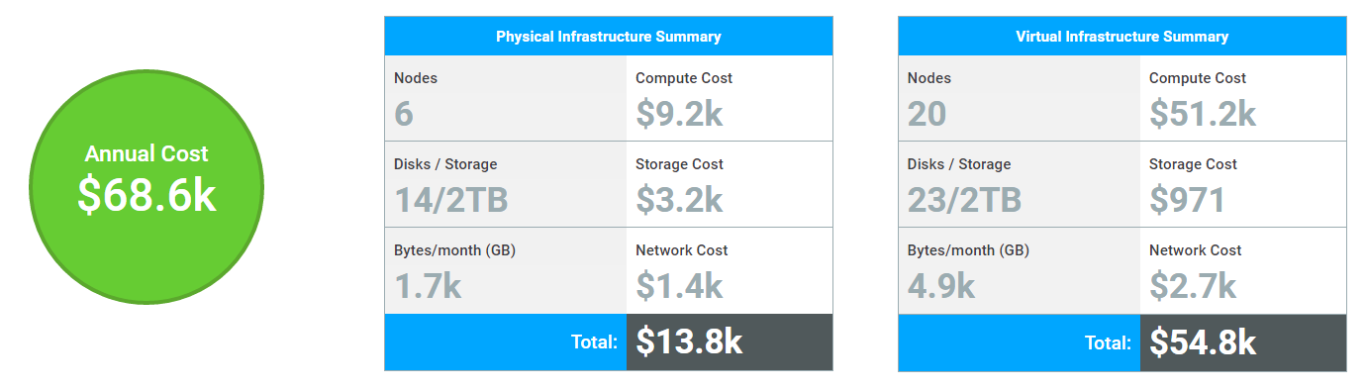
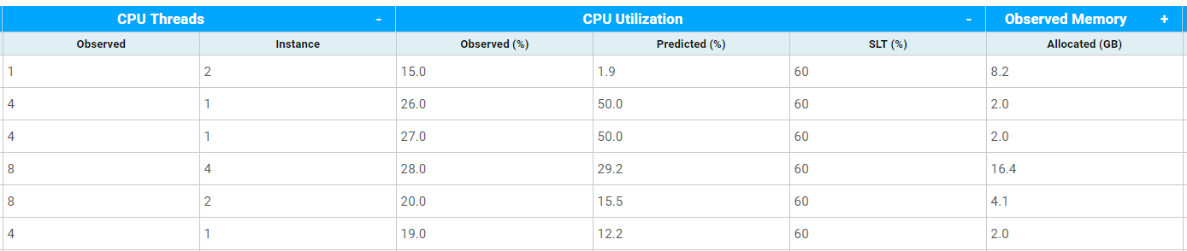
Price and usage breakdown for physical and virtual infrastructure
Cost Analysis, TCO & Right-Sizing
View data observed from your current infrastructure next to the related data from the recommended instance

Slide 73
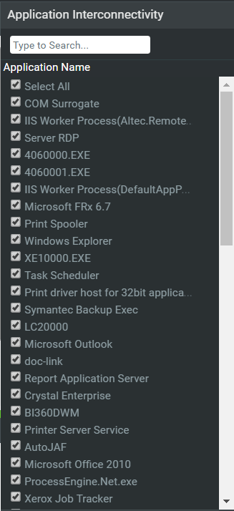
Application Dependencies and complexity
Visualize application interconnectivity between nodes.
View all applications running in your infrastructure and select applications to view interconnectivity.

Slide 74
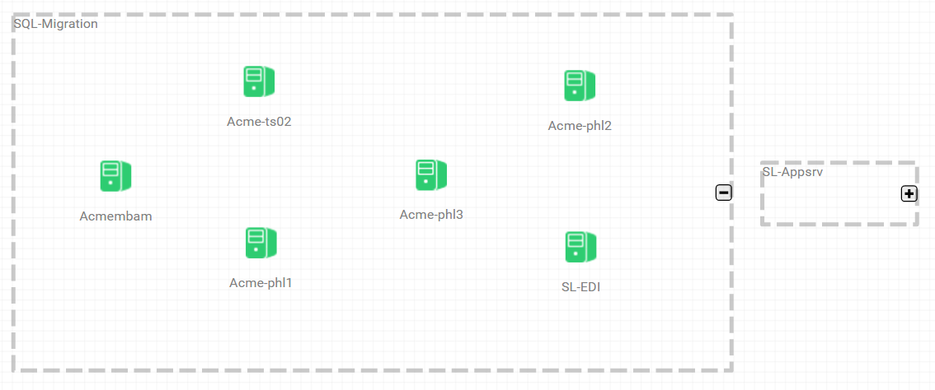
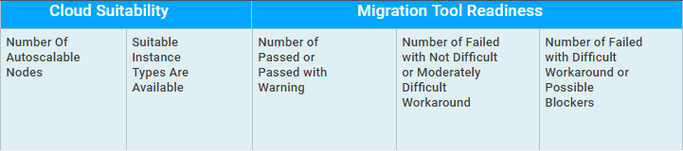
Move Groups & ASR Readiness Analysis
Create move groups, expand and collapse groups, and visualize the migration
Easily view which nodes and move groups are ready for migration

Slide 75
Build Initial Plan
Review results and initial pass of migration plan based on your knowledge of client environment
Revising plan generally includes:
Apply business drivers learned from initial scoping session
Reconcile dependencies based on earlier discussions
Editing configuration, deep dive into specific applications
Building move groups based on discussions using cost, hardware or time as a driver

Slide 76
Working Session with Client to Revise Plan
1
2
3
4
5
6
7

Slide 77
Working Session with the Client
Walk through of the initial findings
Deep dive into proposed migration plan
Working session around below:
Editing business drivers (if needed)
Reconcile dependencies based on the client applications
Editing move groups based on customer’s initial constraints such as
Workload type (DR, Dev/Test, Production etc)
Budget constraints
Application groups
Business drivers
Discuss Azure architecture, networking, security groups
Revise Plan

Slide 78
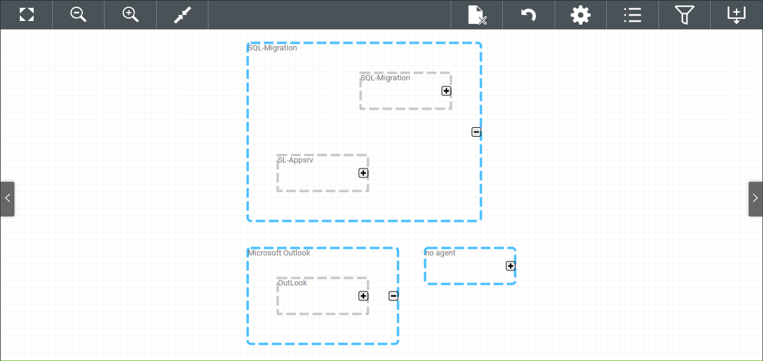
Apply Business Drivers and Quickly Build Move Groups
Undo migration planner changes and rollback to saved changes
Build machines-based move groups – Filter on machine names, OS types, OS version, etc.
Advanced filtering - Allows rule-based move group building and CSV downloads
Build application-based move groups – Filter on application class, vendor name, program name, etc.

Slide 79
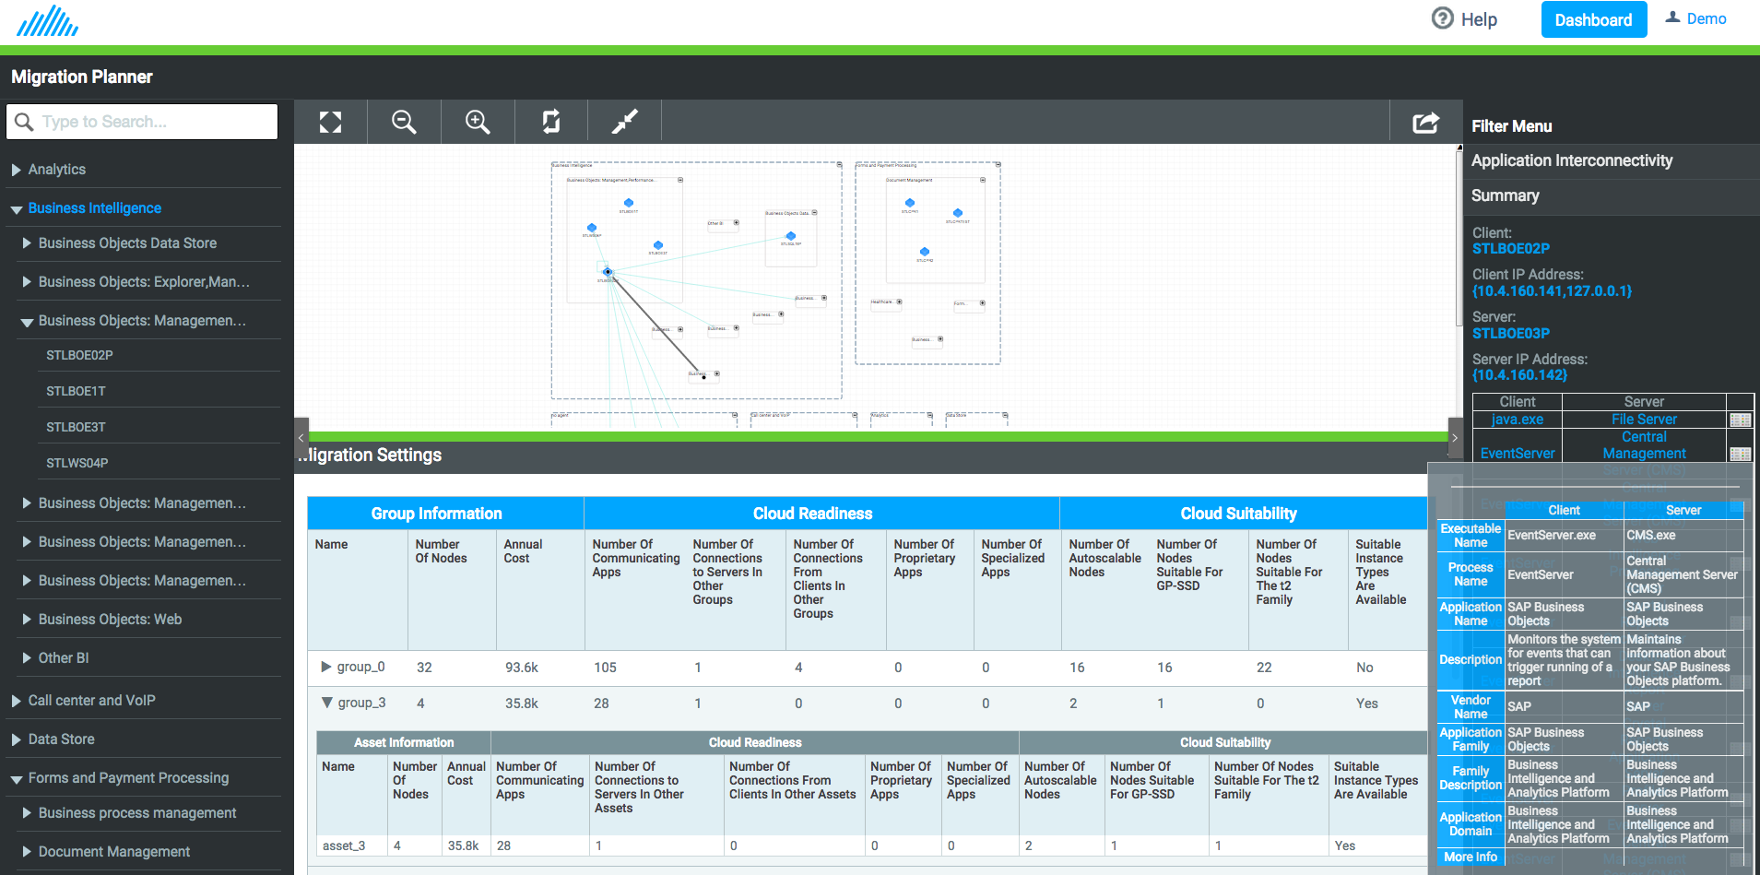
Drill Down into Application Dependency Mapping
Node and application details with firewall rules
Click on a node or edge to see more information
See details about each application connectivity

Slide 80
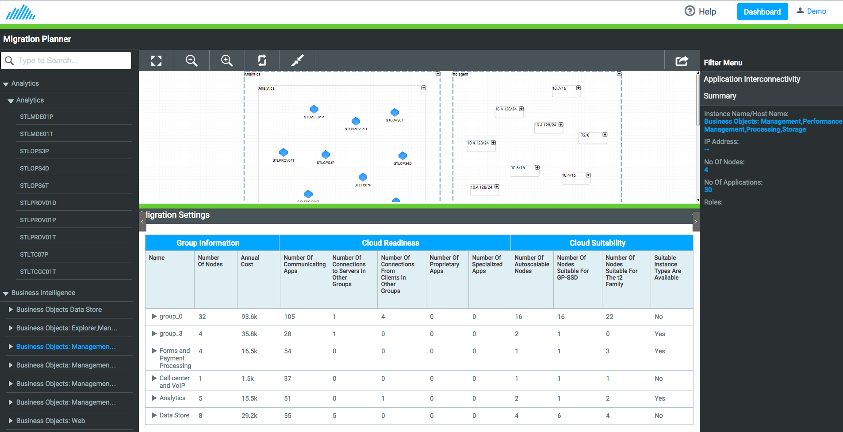
Prioritize Your Applications based on Cloud Readiness and Suitability
Outlines Application Prioritization for a cloud migration based on cost and cloud readiness
Suitability defines if the applications are more suitable to move to the cloud and will be more efficient from cost and performance perspective.
Readiness defines the application complexity for moving to the cloud
Cost by application group

Slide 81
Present/Finalize Migration Plan
6
1
2
3
4
5
7

Slide 82
Finalize Migration Plan
Based on the working session discussion, build final deliverables
Lay out the migration phases and the timeline
Deliverable template available at Sysgain microsite.

Slide 83
Execute Migration Plan Using ASR
6
1
2
3
4
5
7

Slide 84

ASR Readiness Analysis
Find optimal ASR targets by performing ASR compatibility checks
On-Premise Move Group
Azure Instances
SUCCESS
ASR Readiness Checks
WARNING
CRITICAL

Slide 85
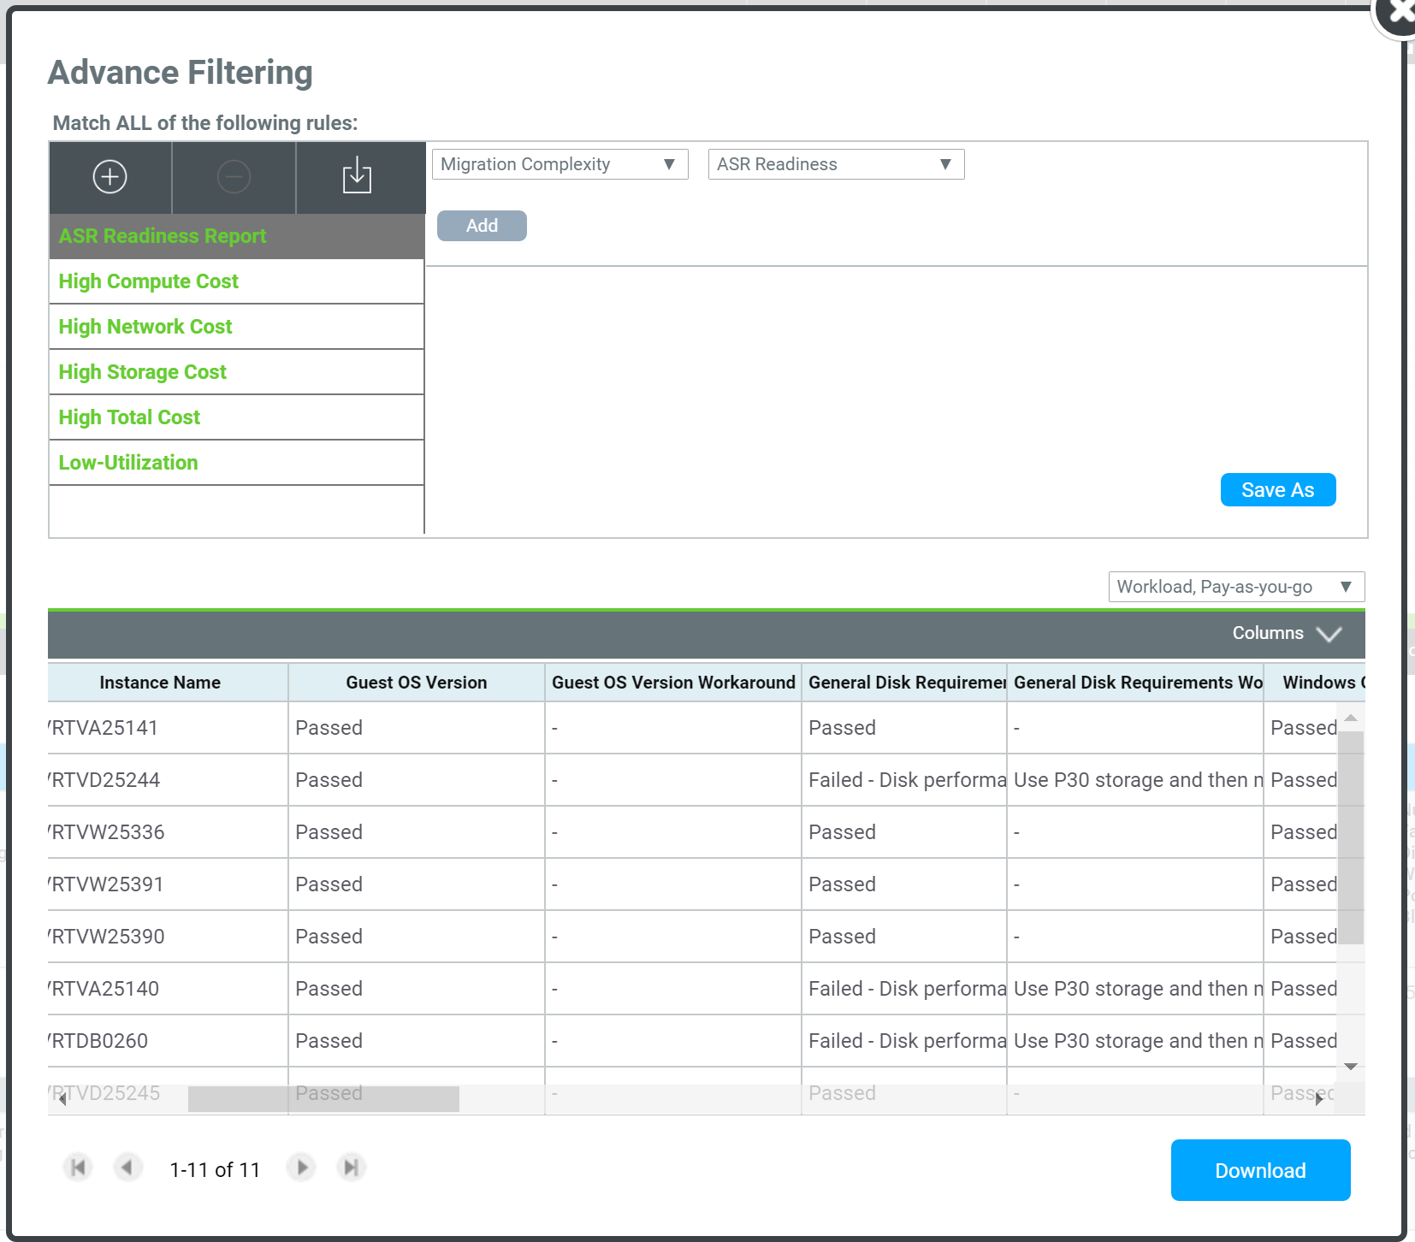
ASR Readiness Report
Validation against ~20 checks to see if the target is ready for ASR migration and divides outcome into Success/Warning/Critical.
Provides workaround for the machines that are identified with “Warning”
Example checks:
General Disk Requirements
Windows OS Requirements
Hypervisor Requirements
Disk Space Requirements
.NET Version Requirements
Boot Software Requirements
Linux System Requirements
Disk’s performance requirement failed but can be achieved by striping data across several disks.
Work around: Use P30 and migrate to RAID 0 after migration
Download detailed analysis

Slide 86
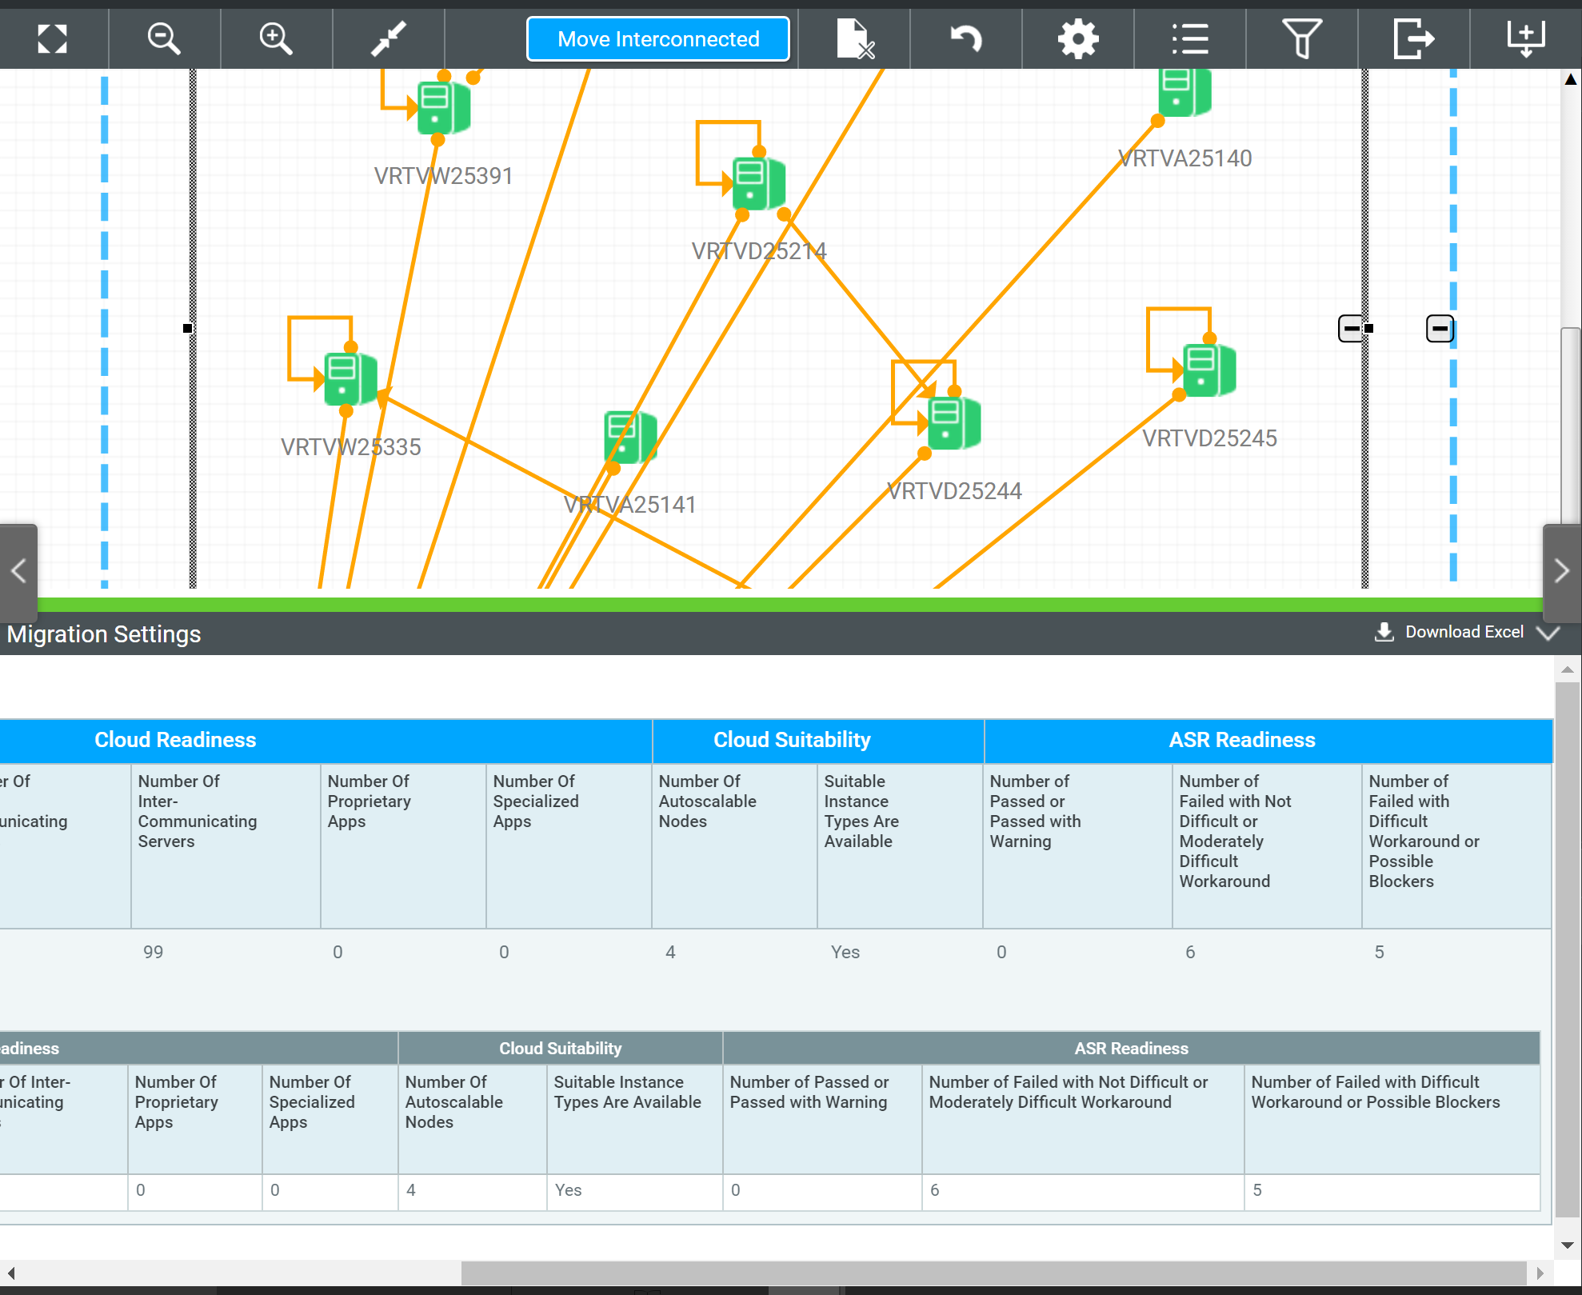
ASR Readiness by Move Group
Use ASR Readiness in prioritizing move groups.
Machines with “SUCCESS” – Migrate them first.
Machines with “WARNING” - Use recommended workaround to fix issue and complete migration to Azure.
View the Cloudamize Tutorial here.
SUCCESS
WARNING
CRITICAL

Slide 87
Steps to Migrate with ASR
Setup Configuration Server
Prepare to Migrate
Migrate
Select a Cloudamize design and a set of move groups
Select a machine to setup as the Configuration Server
Enter the Subscription ID and Resource Group for the Configuration Server
Select the machines to be migrated
Create new configurations or choose existing storage, network, and subnet configurations
Perform migration testing on the configured machines
Execute the migration

Slide 88
Setup Configuration Server
1
2
3

Slide 89

Setup the Configuration Server
1. Select the host to be used as the configuration server
2. Click “Setup”

Slide 90

Specify the Configuration Server Details
1. Enter the subscription ID
2. Enter the Resource Group or create a new one
3. Click “Save”

Slide 91
Prepare to Migrate
1
2
3

Slide 92

Select the Machines for Migration
1. Check the boxes next to the hosts to be migrated
2. Select “Prepare To Migrate” from the drop-down list
3. Click “Go”

Slide 93

Prepare the Selected Machines for Migration
1. Select existing Storage, Network, and Subnet configurations or create new ones
2. Click “Save”

Slide 94
Migrate
1
2
3

Slide 95

Migrate the Selected Hosts
1. Select hosts to migrate
3. Click “Go”
2. Select Migrate

Slide 96

Start/Stop Migration Testing and Disable Migration
1. Select hosts to perform additional actions on
2. Select additional actions to perform on the selected servers
3. Click “Go”

Slide 97
Partner Dashboard

Slide 98
Partner Dashboard Benefits
Available at: dashboard.cloudamize.com
Deal registration
Manage accounts on Cloudamize application
View status of assessments
Identify errors
Access to knowledge base
Launch Demo Account

Slide 99

Managing Customers
Manage your accounts
See assessment status progress
Launch Cloudamize application

Slide 100

Managing Customers
Add account executives or solutions engineers on the dashboard
Assign different roles
Access to knowledge base
View the Cloudamize Tutorial here.

Slide 101
Support

Slide 102


Support
Details
Tools:
Microsite – Content hub and support ticket tracking system used for handling ALL business and technical support issues (shown on right).
Sysgain Service Level Agreement (Migration Program):
Provide support services to MSP Partners.
Initial response within 2 hours of submitting issue.
48-72 hour resolution time for normal issues.
Critical issues escalated and monitored regularly until resolution.
Support Links
https://cspmigration.freshdesk.com/support/home
Or Email requests to: support+cspmigration@sysgain.com

Slide 103
Promotion Offer

Slide 104
Thank you.
Adi Rao
Partner Development Manager
arao@Cloudamize.com

